Slide 1
Android Bug Fixes
Nevermore App

Slide 2
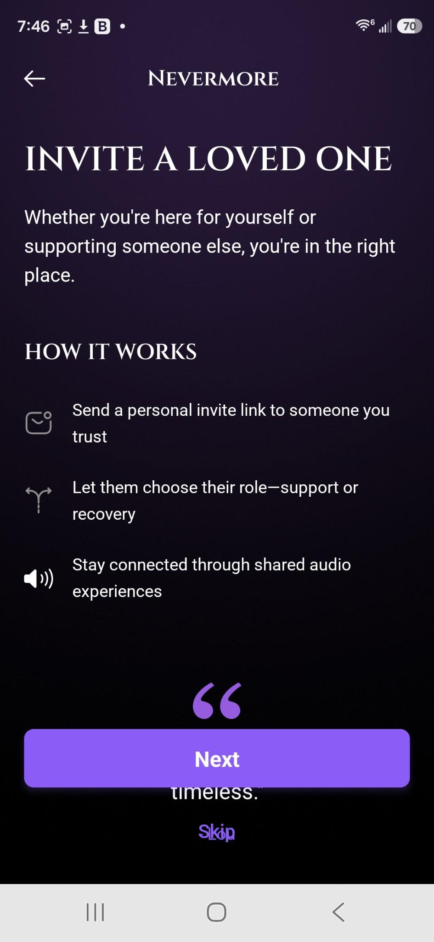
Invite a Loved One Screen (after account creation)
The “next” and “skip button” are over the top the quote.
Please correct positioning

Slide 3
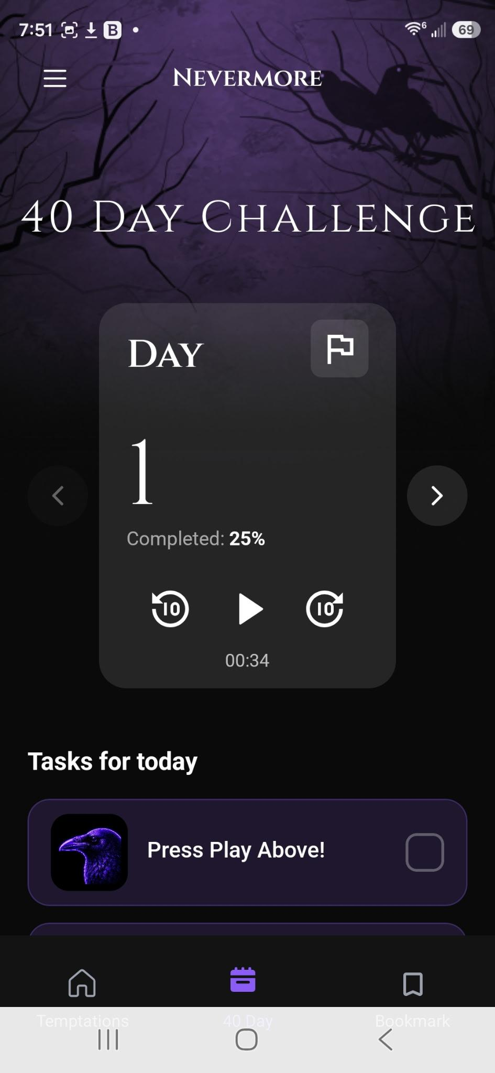
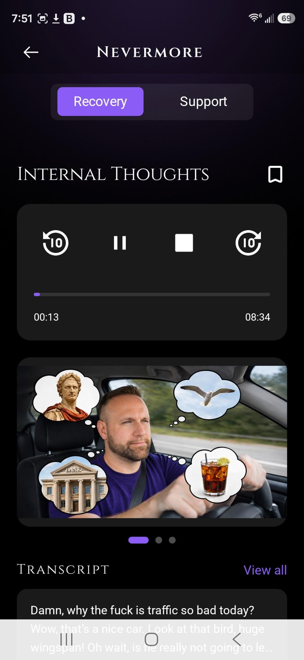
- 10 seconds +10 second seek controls not working
When trying to fast forward through content either in the 40 day journey or in the temptations, it does not work.
This issue is sporadic.
Please correct so that the media player has full functionality.

Slide 4
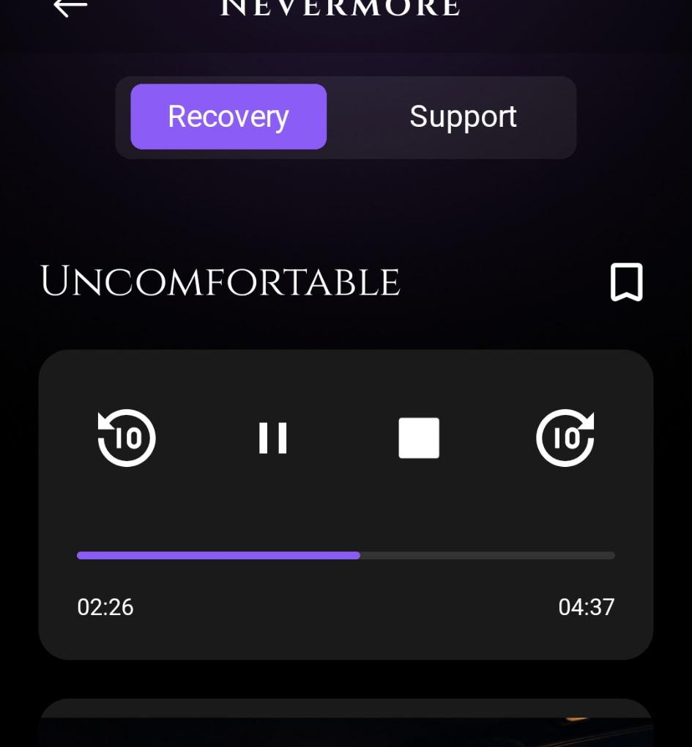
Seek / Scrubber BAR
The seek/scrubber bar is unresponsive in temptations. It allows me to drag it in some content, but not others. Instead, when trying to pull the scrubber - it restarts the audio.

Slide 5
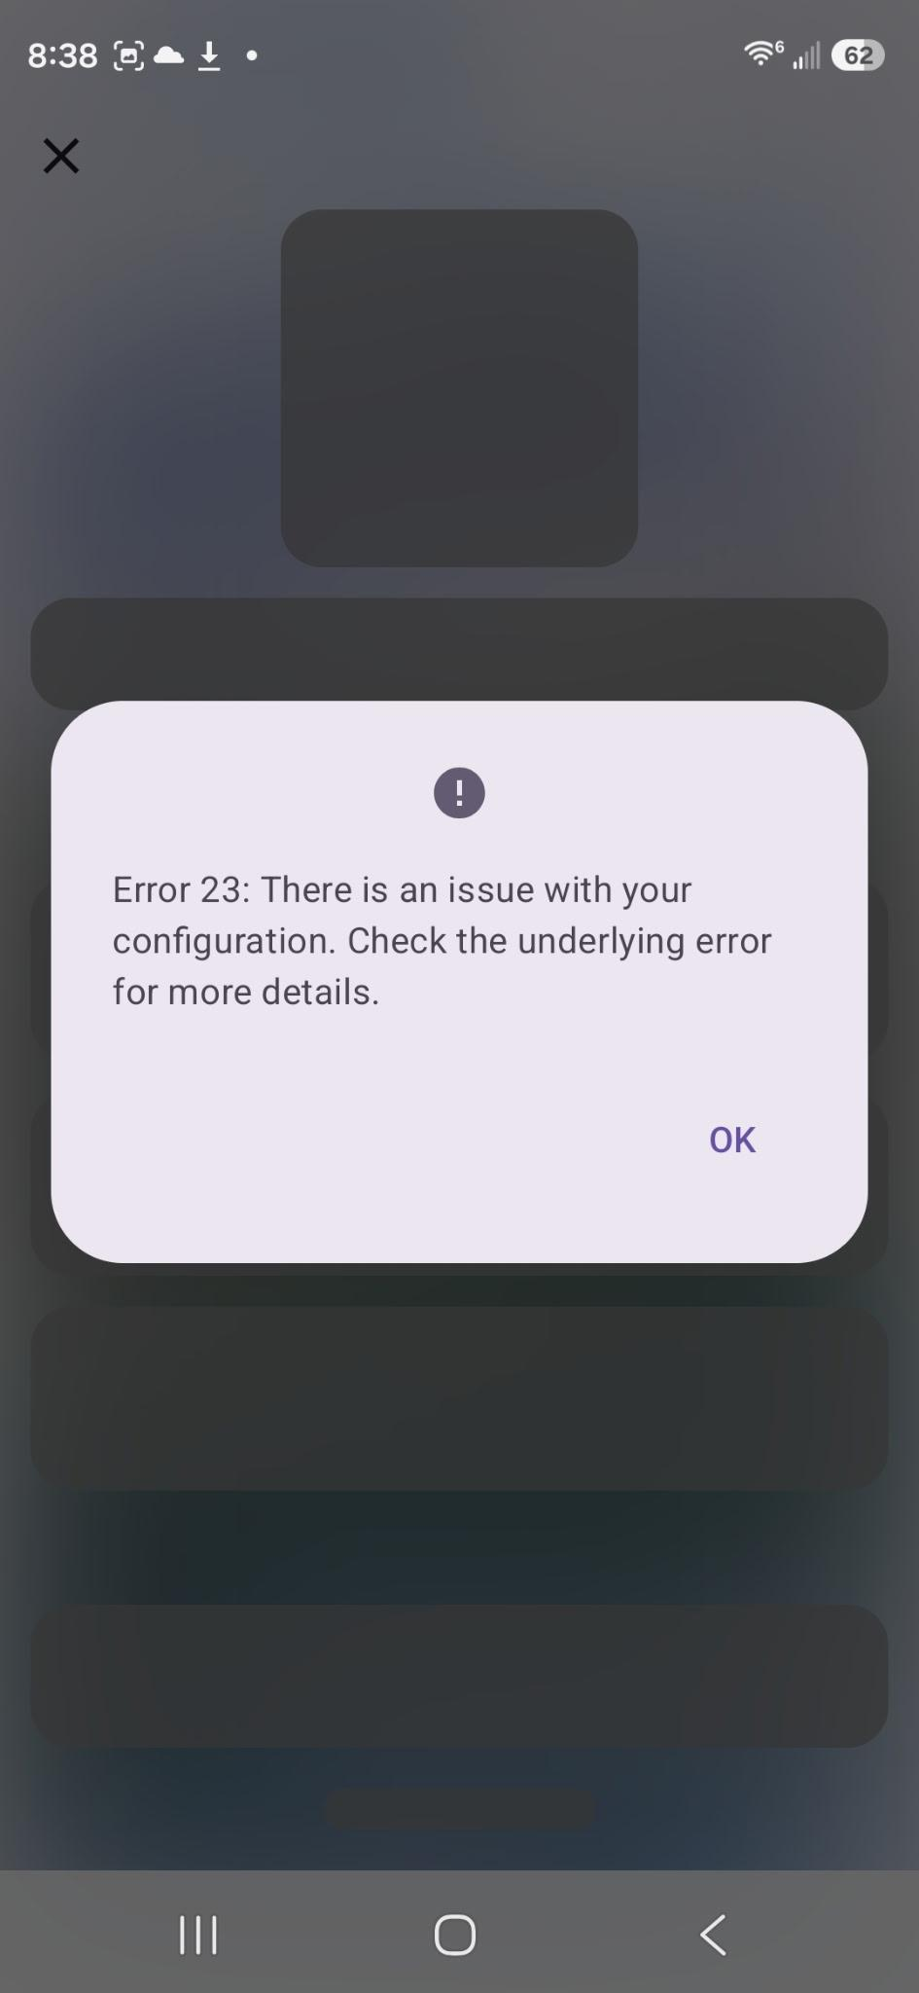
Subscription Selection
Subscription Selection is not possible for Android. Please Connect it to RevenueCat

Slide 6
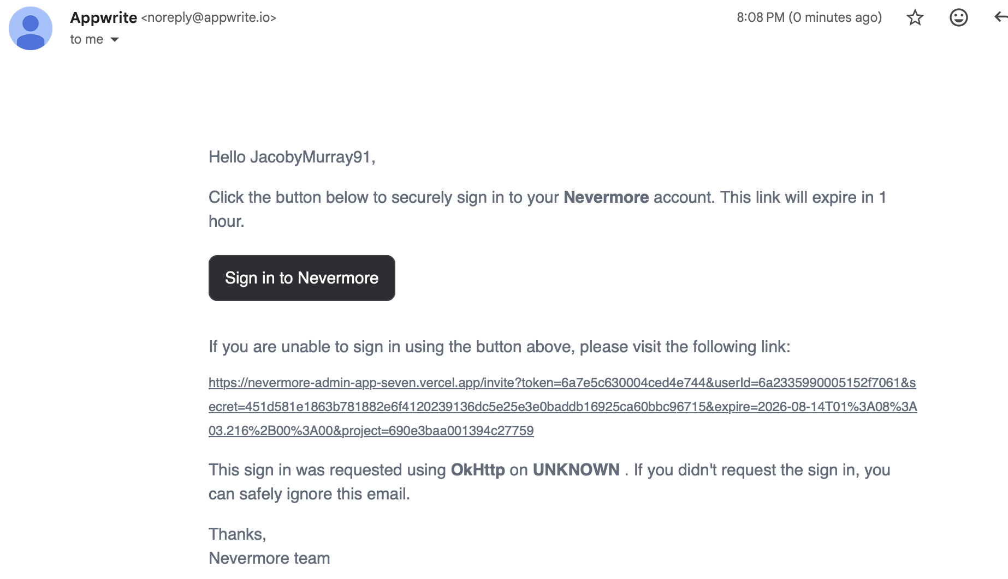
Invitation Links still sending from Appwrite
Invitation links sent through the app are still coming through Appwrite and not BREVO,
I know you are already aware of this problem and are actively working on it with the apple version as well.

Slide 7
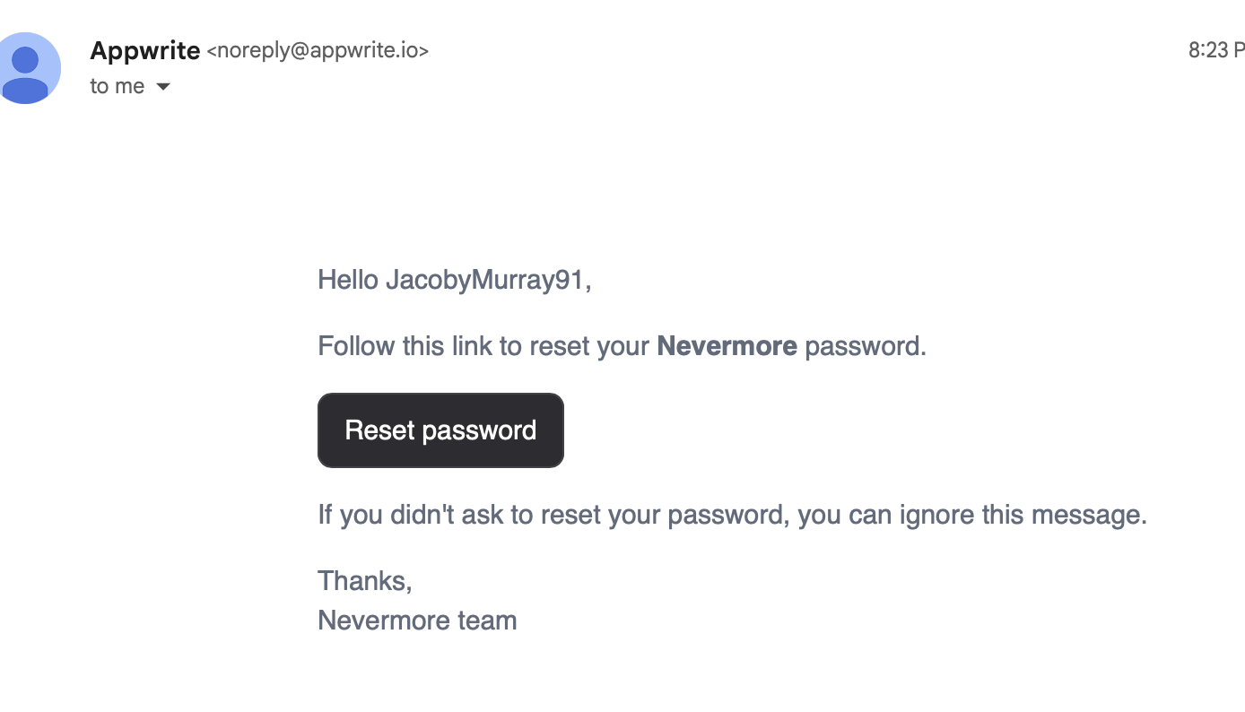
Password Reset Still coming from Appwrite
I assume that once that once Brevo is properly connected, people will be able to reset their passwords - that it will show their correct account information.

Slide 8
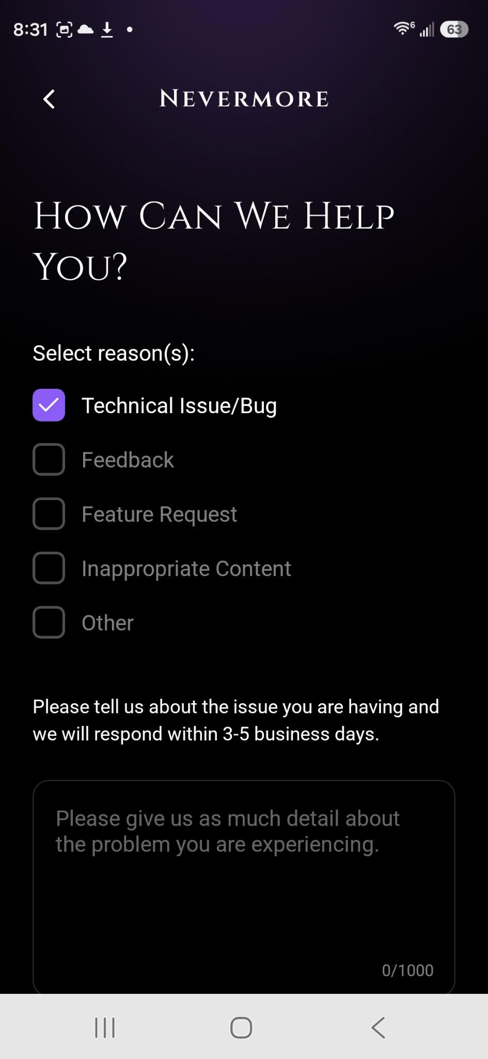
Not sure where to look for customer complaints
Once the Brevo is connected, I am sure that I will be able to see customer feedback.
I tried to test it, but couldn’t find where these go. I checked nevermoreapp@gmail and Louis@nevermoreapp.com

Slide 9
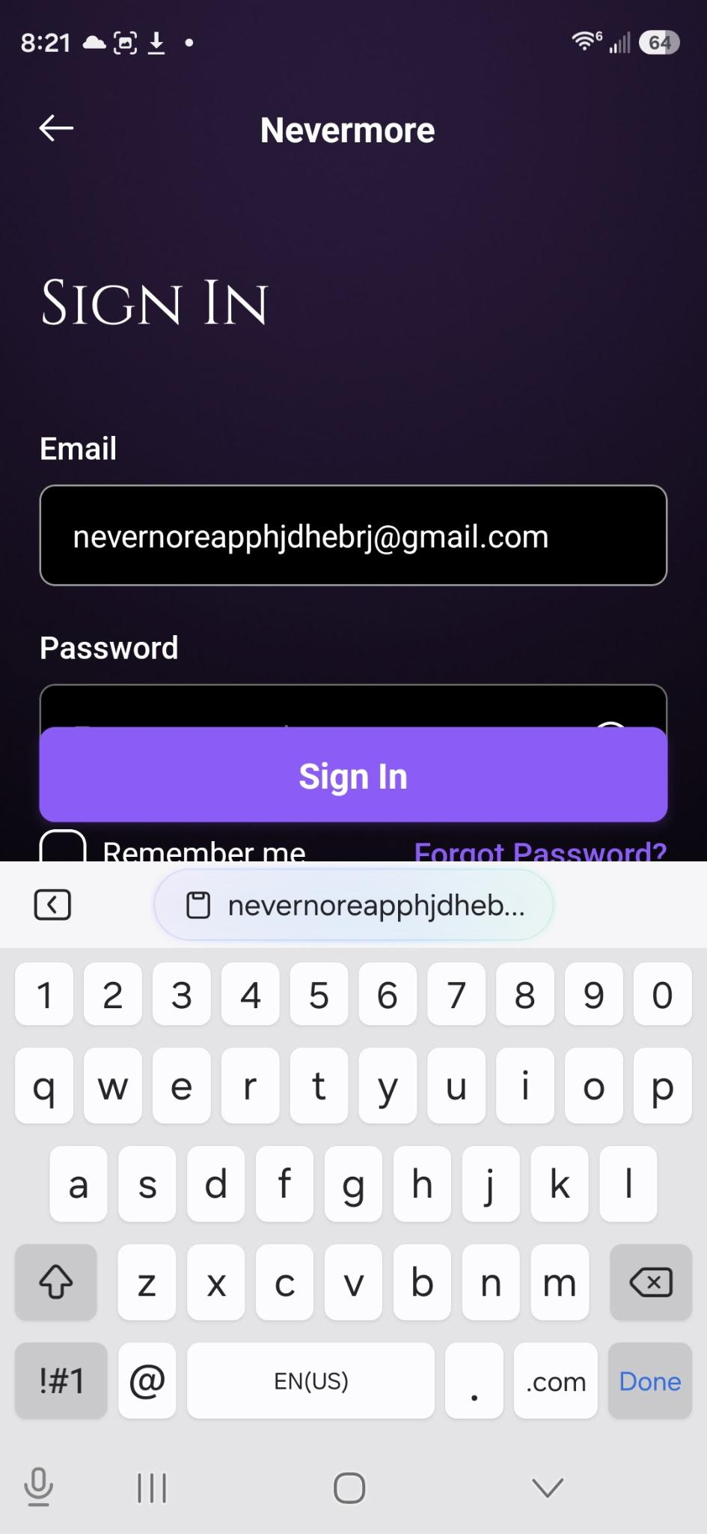
Sign in Screen (after account has been created)
The sign in button overlaps the password bar.
Please correct.

